Slide 1
M.Tech.(AIML) Introduction to Statistical Methods
Team ISM

Slide 2
Session No 4
Bayes theorem &
Introduction to Naïve Bayes concept
(Session 4: 3rd/4th Dec 2022)

Slide 3
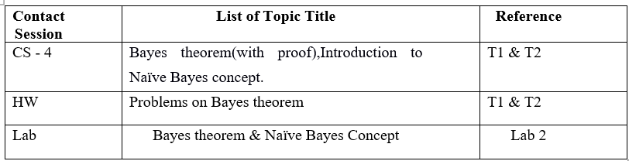
Contact Session 4

Slide 4
Agenda
Bayes Theorem
Introduction to Naïve Bayes concept
Text Books
No | Author(s), Title, Edition, Publishing House
T1 | Statistics for Data Scientsists, An introduction to probability, statistics and Data Analysis, Maurits Kaptein et al, Springer 2022
T2 | Probability and Statistics for Engineering and Sciences, 8th Edition, Jay L Devore, Cengage Learning

Slide 5
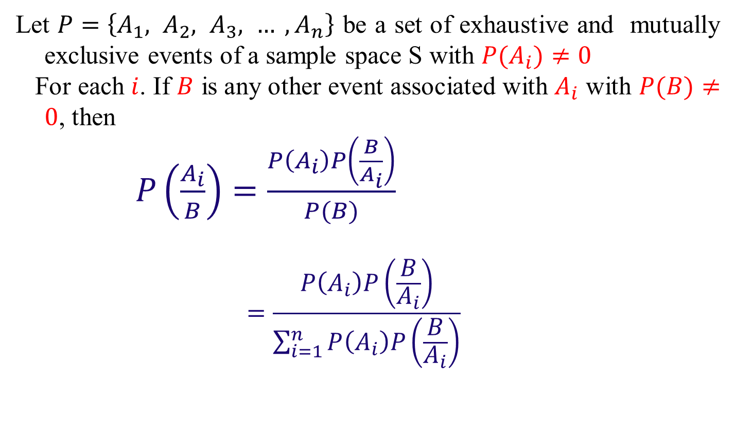
BAYES' THEOREM
Let $P=\left\{A_{1}, A_{2}, A_{3}, … , A_{n}\right\}$ be a set of exhaustive and mutually exclusive events of a sample space S with $P(A_{i})≠0$
For each $i$. If $B$ is any other event associated with $A_{i}$ with $P(B)≠0$, then
$P\left(\frac{A_{i}}{B}\right)=\frac{P\left(A_{i}\right)P\left(\frac{B}{A_{i}}\right)}{P(B)}$
$$=\frac{P\left(A_{i}\right)P\left(\frac{B}{A_{i}}\right)}{\sum_{i=1}^{n}{P\left(A_{i}\right)P\left(\frac{B}{A_{i}}\right)}}$$

Slide 6

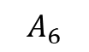
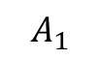
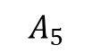
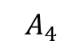
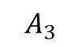
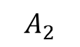
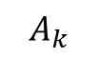
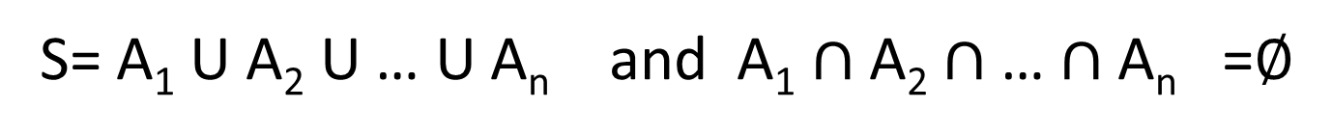
Geometrical Representation of Bayes theorem
S= A₁ U A₂ U … U A_{n} and A₁ $∩$ A₂ $∩$ … $∩$ A_{n} =$∅$
B
$$A_{5}$$
S
$$A_{1}$$
$$A_{3}$$
$$A_{4}$$
$$A_{6}$$
$$A_{2}$$
$$A_{k}$$

Slide 7
Proof:
The conditional Probability of A_{i} for any i given B is given as
But we know that
&
Hence the theorem proved

Slide 8
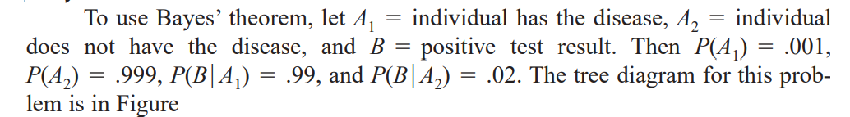
Example:
Only 1 in 1000 adults is afflicted with a rare disease for which a diagnostic test has been developed. The test is such that when an individual actually has the disease, a positive result will occur 99% of the time, whereas an individual without the disease will show a positive test result only 2% of the time. If a randomly selected individual is tested and the result is positive, what is the probability that the individual has the disease?

Slide 9
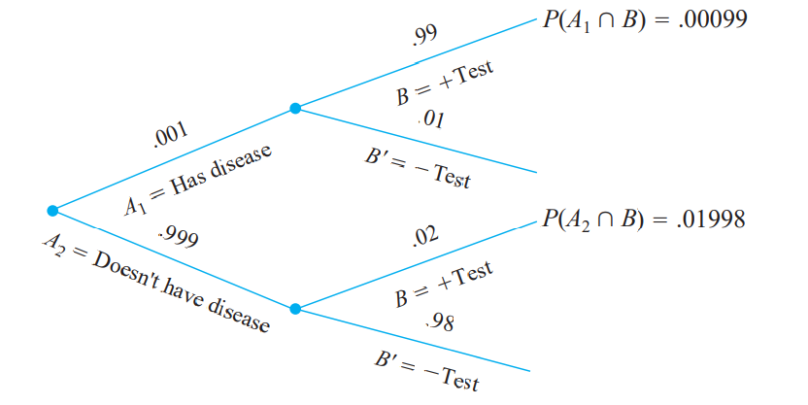
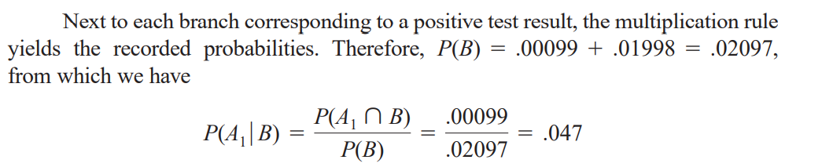

Slide 10
Example:
A certain firm has plants A, B, C producing, respectively 35%, 15% and 50% of the total output. The probabilities of a non – defective product are, respectively, 0.75, 0.95 and 0.85. A Customer receives a bad product, what is the Chance that product came from the plant C?

Slide 11
Tree Diagram
Product is Defective
A
Product is not defective
Product is defective
Firm
B
Product is non-defective
Product is found to be Bad
C
Product is good

Slide 12
Solution
Let X: “ Customer receives a defective product”.
Clearly, P(X)=
=0.17
Therefore, the chance that product is manufactured by the plant C is
= 0.4412
=

Slide 13
Example
The chances that an academician, a business man and a politician becoming Vice Chancellor of an university are 0.5, 0.3 and 0.2 respectively. The probability that research work will be promoted in the university by these 3 gentlemen are respectively are 0.8, 0.6 and 0.4. It is found Research work has been promoted by the university. What is the chance that an academician has become the VC?

Slide 14
Tree Diagram
Research Promoted
0.8
0.2
0.5
A
Not
0.6
Yes
VC
0.3
B
0.4
0.2
Not
0.4
Yes
P
P
0.6
Not

Slide 15
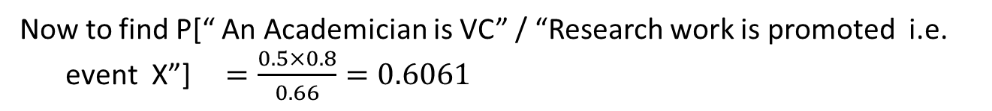
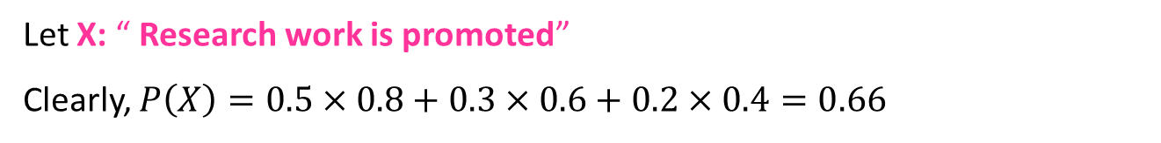
Example
The chances that an academician, a business man and a politician becoming Vice Chancellor of an university are 0.5, 0.3 and 0.2 respectively. The probability that research work will be promoted in the university by these 3 gentlemen are respectively are 0.8, 0.6 and 0.4. It is found Research work has been promoted by the university. What is the chance that an academician has become the VC?
Let X: “ Research work is promoted”
Clearly, $P\left(X\right)=0.5×0.8+0.3×0.6+0.2×0.4=0.66$
Now to find P[“ An Academician is VC” / “Research work is promoted i.e. event X”]$=\frac{0.5×0.8}{0.66}=0.6061$

Slide 16
Example: A manufacturer of tablets receives its LED screens from three different suppliers, 60% from supplier B1, 30% from supplier B2, and 10% from supplier B3. In other words, the probabilities that any one LED screens received by the plant comes from these three suppliers are 0.60, 0.30, and 0.10. Also suppose that 95% of the LED screens from B1, 80% of those from B2, and 65% of those from B3 perform according to specifications.
1) What is the probability that any one LED screen received by the plant will perform according to specifications?
2) Determine the probability that a particular LED screen, which is known to perform according to specifications, came from supplier B3.

Slide 17
If A denotes the event that a LED screen received by the plant performs according to specifications, and B1, B2, and B3 are the events that it comes from the respective suppliers
A = A ∩ [B1 ∪ B2 ∪ B3]
= ( A ∩ B1 ) ∪ ( A ∩ B2 ) ∪ ( A ∩ B3)
= P( A ∩ B1 ) + P( A ∩ B2 ) + P( A ∩ B3 )
P( A ) = P( B1 ) ・ P( A | B1 ) +
P( B2 ) ・ P( A | B2 )
+ P( B3 ) ・ P( A | B3 )
P( A ) = ( 0.60 )( 0.95 ) + ( 0.30 )( 0.80 ) + ( 0.10 )( 0.65 )
= 0.875
P( B3 | A ) = ( 0.10 )( 0.65 )
----------------------------------------------------------- = 0.074
( 0.60 )( 0.95 ) + ( 0.30 )( 0.80 ) + ( 0.10 )( 0.65 )

Slide 18
Suggested Problems
Example: Two firms V and W consider bidding on a road-building job, which may or may not be awarded depending on the amounts of the bids. Firm V submits a bid and the probability is ¾ that it will get the job provided firm W does not bid. The probability is ¾ that W will bid, and if it does, the probability that V will get the job is only1/3. (a) what is the probability that V will get the job? (b) If V gets the job, what is the probability that W did not bid?
Answer: Given P(V/W¹)=3/4, P(W) = 1/3, P(V/W)=1/3 P(W¹) = 2/3
(a) V = (V∩W)U(V∩W¹) = > P(V) = P(V∩W) + P(V∩W¹)
P(V) = P(V/W) P(W) + P(V/W¹) P(W¹) = 11/18
(b) P(W¹/V) = P(V/W¹) P(W¹) / P(V) = 9/11

Slide 19
Suggested Problems
Example. An office has 4 secretaries handling respectively 20%, 60%,15% and 5% of the files of all government reports. The probability that they misfile such reports are respectively 0.05, 0.1, 0.1 and 0.05. Find the probability that the misfiled report can be blamed on the first secretary.
Example . In a class 70% are boys and 30% are girls. 5% of boys and 3% of girls are irregular to the classes. What is the probability of a student selected at random is irregular to the classes and what is the probability that the irregular student is a girl?

Slide 20
Suggested Problems
Example 5. Three machines A, B and C produce respectively 60%, 30% and 10% of the total number of items of a factory. The percentage of defective outputs of these machines are 2%, 3% and 4%. An item is selected at random and is found to be defective. (i) Find the probability that the item was produced by machine C? (ii) What is the probability that the item was produced by machine C or B?

Slide 21
Bayesian Learning
Naive Bayes is a set of simple and efficient machine learning algorithms for solving a variety of classification and regression problems.
Naive Bayes assumes conditional independence where Bayes theorem does not. This means the relationship between all input features are independent.
Bayesian learning algorithms that calculate explicit probabilities for hypotheses, such as the naive Bayes classifier, are among the most practical approaches to certain types of learning problems
For example: Problem of learning to classify text documents such as electronic news articles.
For such learning tasks, the naive Bayes classifier is among the most effective algorithms known

Slide 22
Features of Bayesian learning
Prior knowledge can be combined with observed data to determine the final probability of a hypothesis.
Prior knowledge is provided by asserting
prior probability for each candidate hypothesis, and
probability distribution over observed data for each possible hypothesis.
New instances can be classified by combining the predictions of multiple hypotheses, weighted by their probabilities.

Slide 23
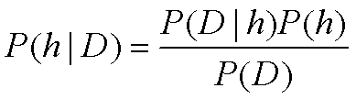
Bayes Theorem
P(h) = prior probability of hypothesis h, before seeing the training data
P(D) = prior probability of training data D
P(h|D) = probability of h given D
P(D|h) = probability of D given h

Slide 24
Bayes Theorem: Example
Consider a medical diagnosis problem in which there are two alternative hypotheses:
H1:That a patient has a particular form of cancer
H2:That the patient does not
The available data is from a particular laboratory test with two possible outcomes
+ Positive
- Negative
Over the entire population of people only 0.008 have this disease. The test returns a corrective positive result in only 98% of the cases in which the disease is actually present and a correct negative result in only 97% of the cases in which the disease is not present.
How does P(cancer/+) compare to P(~ cancer/+)?

Slide 25
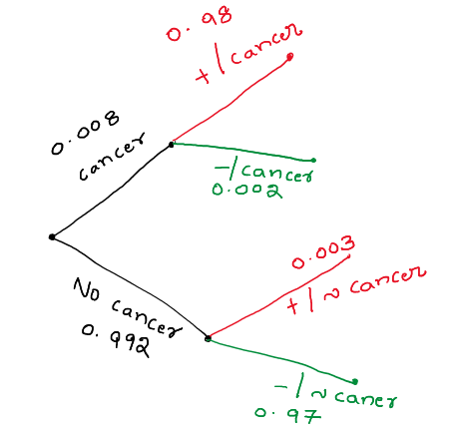
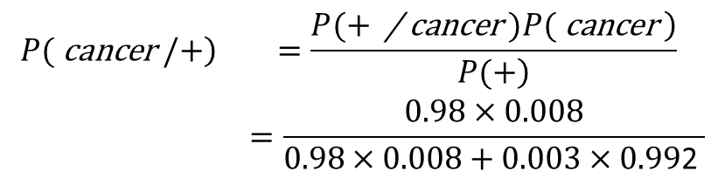
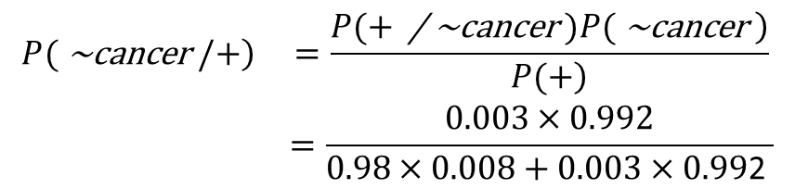
Bayes Theorem: Example
$$\begin{matrix}\left.P( \text{cancer} /+\right) & =\frac{\left.P(+ \text{/} \text{cancer} )P( \text{cancer} \right)}{\left.P(+\right)} \\ & =\frac{0.98×0.008}{0.98×0.008+0.003×0.99\text{2} }\end{matrix}$$
= 0.72485
$$\begin{matrix}\left.P( \text{\sim }\text{cancer} /+\right) & =\frac{\left.P(+ \text{/} \text{\sim }\text{cancer} )P( \text{\sim }\text{cancer} \right)}{\left.P(+\right)} \\ & =\frac{0.003×0.992}{0.98×0.008+0.003×0.99\text{2} }\end{matrix}$$
= 0.27515

Slide 26
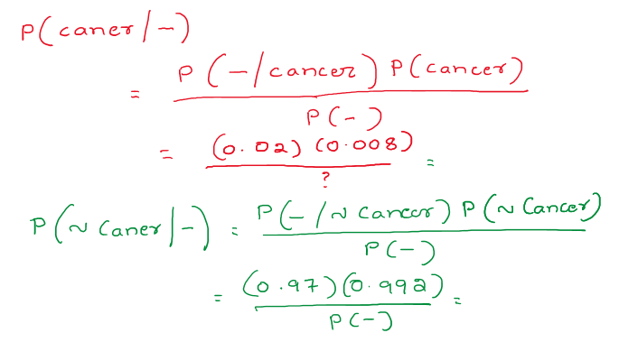
Bayes Theorem: Example

Slide 27
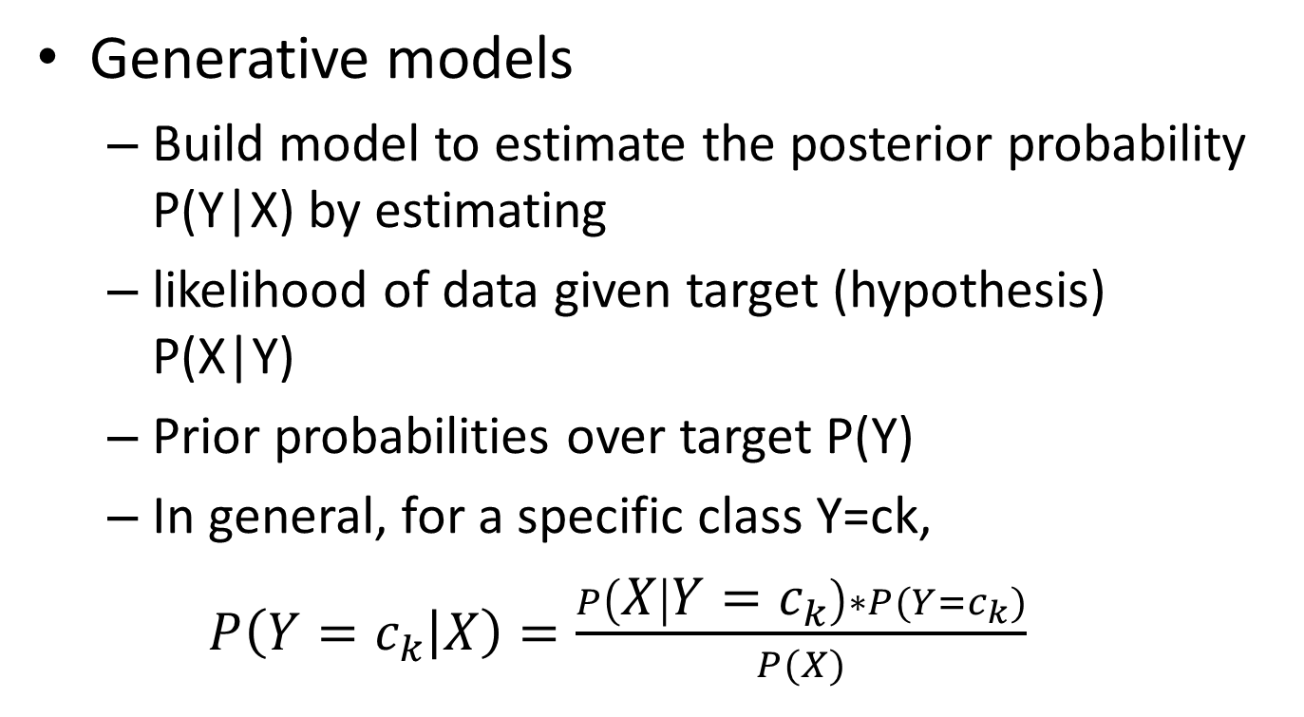
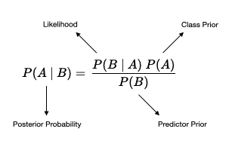
Machine Learning

Slide 28
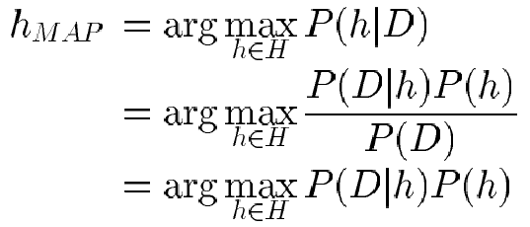
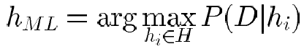
Choosing Hypotheses
Generally want the most probable hypothesis given the training data
Maximum a posteriori hypothesis h_{MAP}:
If assume P(h_{i}) = P(h_{j}) then can further simplify, and choose the Maximum likelihood (ML) hypothesis

Slide 29
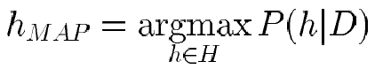
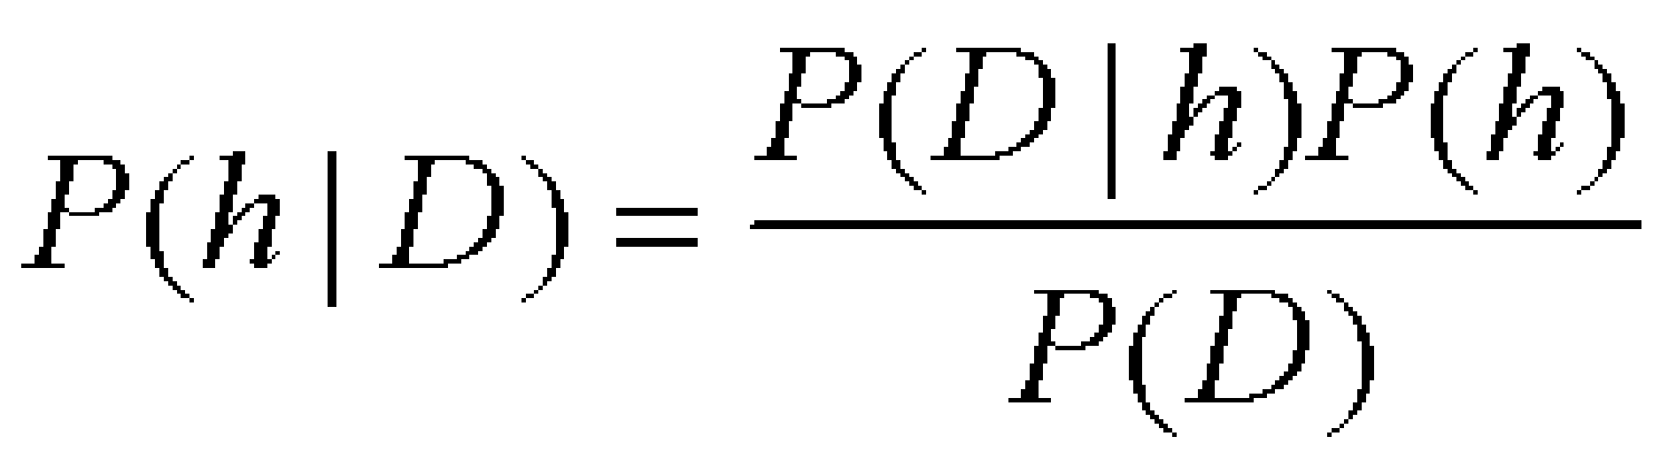
Brute Force MAP Hypothesis
For each hypothesis h in H, calculate the posterior probability
Output the hypothesis h_{MAP} with the highest posterior probability

Slide 30
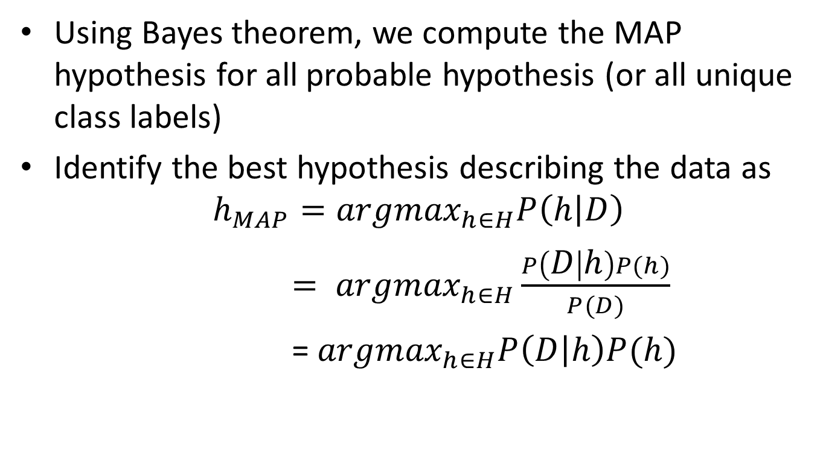
MAP Hypothesis
P(D) is independent of h and is same for all hypothesis, therefore dropped
H: set of all hypothesis

Slide 31
Maximum Likelihood Estimation
When no prior information is available, all hypothesis are equally likely i.e p(hi) = p(hj)
This is also true for a balanced class problem where all the classes are equally likely
This is known as uniform prior
MAP hypothesis further simplified to
h_{ML} = argmax P(D/h) ( where h belongs to H)

Slide 32
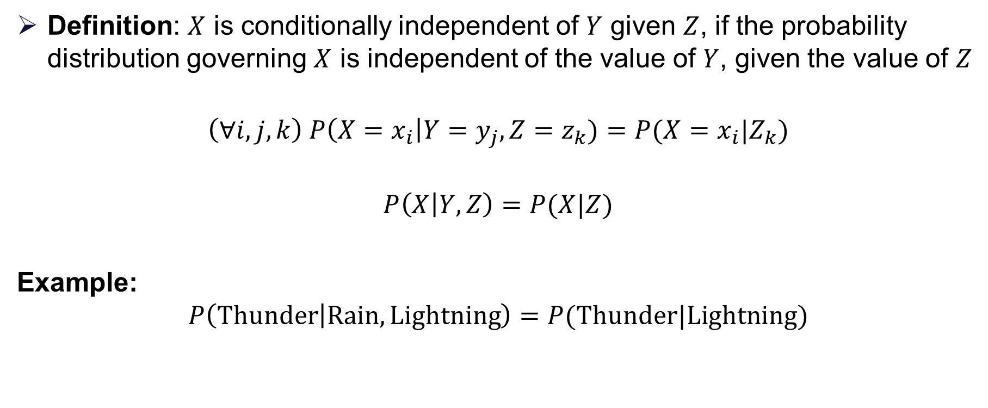
Conditional independence
Definition: $X$ is conditionally independent of $Y$ given $Z$, if the probability distribution governing $X$ is independent of the value of $Y$, given the value of $Z$
$$\left(∀i,j,k\right) P\left(X=x_{i}\right|Y=y_{j}, Z=z_{k})=P(X=x_{i}|Z_{k})$$
$$P\left(X | Y, Z\right)=P(X|Z)$$
Example:
$$P\left(Thunder | Rain, Lightning\right)=P(Thunder|Lightning)$$

Slide 33
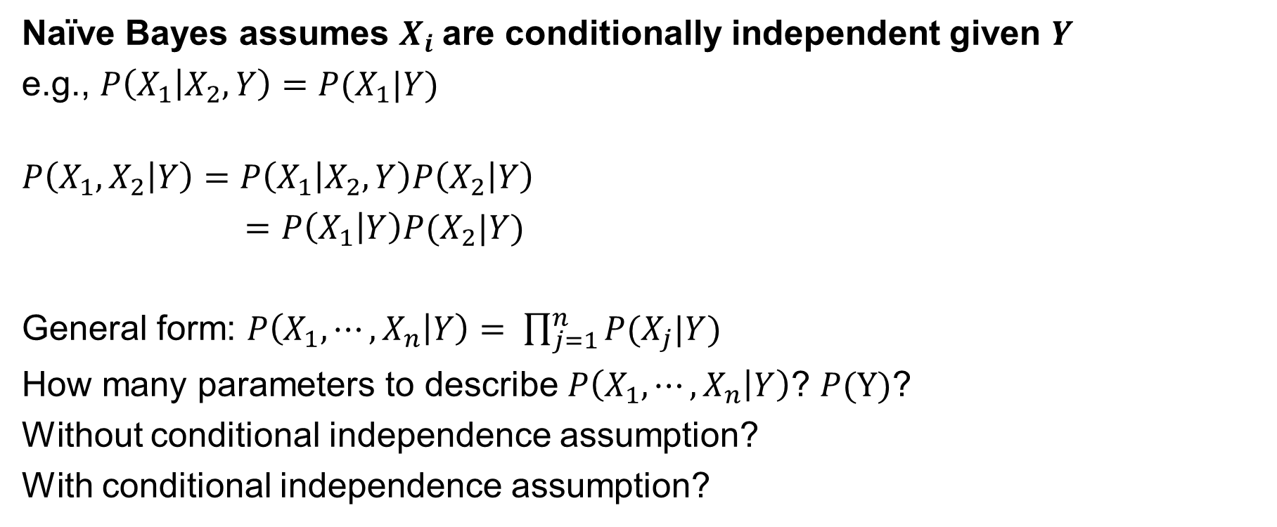
Applying conditional independence
Naïve Bayes assumes $X_{i}$are conditionally independent given $Y$
e.g., $P\left(X_{1} | X_{2}, Y\right)=P(X_{1}|Y)$
$$P\left(X_{1}, X_{2} | Y\right)=P\left(X_{1} | X_{2},Y\right)P\left(X_{2} | Y\right)$$
$=P\left(X_{1} | Y\right)P(X_{2}|Y)$
General form: $P\left(X_{1}, ⋯,X_{n} | Y\right)= \prod_{j=1}^{n}{P(X_{j}|Y)}$
How many parameters to describe $P\left(X_{1}, ⋯,X_{n} | Y\right)$? $P(Y)$?
Without conditional independence assumption?
With conditional independence assumption?

Slide 34
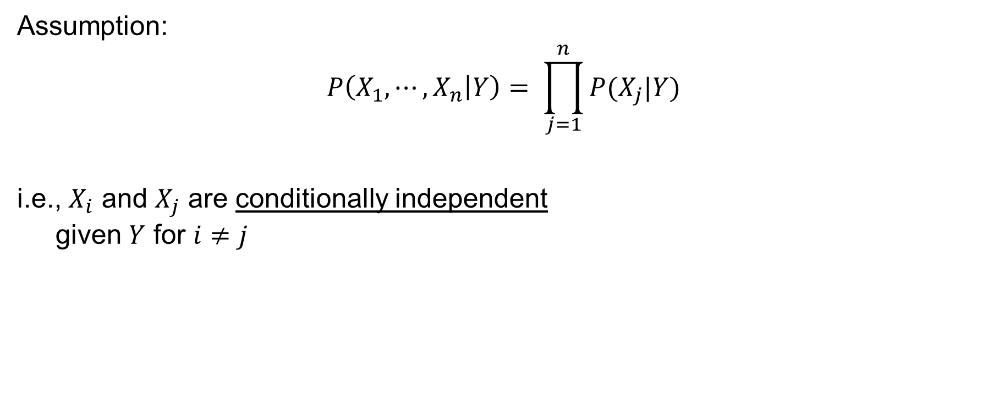
Naïve Bayes Independence assumption
Assumption:
$$P\left(X_{1}, ⋯,X_{n} | Y\right)= \prod_{j=1}^{n}{P(X_{j}|Y)}$$
i.e., $X_{i}$ and $X_{j}$ are conditionally independent given $Y$ for $i≠j$

Slide 35
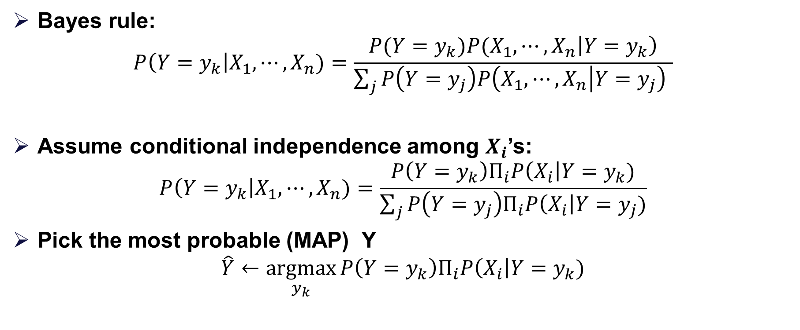
Naïve Bayes classifier
Bayes rule:
$$P\left(Y=y_{k}\right|X_{1}, ⋯,X_{n})=\frac{{P(Y=y_{k})P(X_{1},⋯,X}_{n}\left|Y=y_{k}\right)}{\sum_{j}{P\left(Y=y_{j}\right)P\left(X_{1},⋯, X_{n} | Y=y_{j}\right) }}$$
Assume conditional independence among $X_{i}$’s:
$$P\left(Y=y_{k}\right|X_{1}, ⋯,X_{n})=\frac{P\left(Y=y_{k}\right)Π_{i}P\left(X_{i}\right|Y=y_{k})}{\sum_{j}{P\left(Y=y_{j}\right)Π_{i}P\left(X_{i}\right|Y=y_{j})}}$$
Pick the most probable (MAP) Y
$$\hat{Y}←\underset{y_{k}}{argmax}{P\left(Y=y_{k}\right)Π_{i}P\left(X_{i}\right|Y=y_{k})}$$
Prior Probability
MLE

Slide 36
NAÏVE BAYES CLASSIFIER
Assume independence among attributes X_{i} when class is given:
P(X₁, X₂, …, X_{d} |Y_{j}) = P(X₁| Y_{j}) P(X₂| Y_{j})… P(X_{d}| Y_{j})
Now we can estimate P(X_{i}| Y_{j}) for all X_{i} and Y_{j} combinations from the training data
New point is classified to Y_{j} if P(Y_{j}) Π P(X_{i}| Y_{j}) is maximal.

Slide 37
Example 1:
Weather | Play
Sunny | No
Overcast | Yes
Rainy | Yes
Sunny | Yes
Sunny | Yes
Overcast | Yes
Rainy | No
Rainy | No
Sunny | Yes
Rainy | Yes
Sunny | No
Overcast | Yes
Overcast | Yes
Rainy | No
If the weather is sunny,
then the player will play
or not?
i.e. Play/ Sunny = Yes or No
Note if we know P(Yes/Sunny) and P(No/Sunny) then we can answer the question asked

Slide 38
Steps to Apply Bayes Theorem
Weather | Play
Sunny | No
Overcast | Yes
Rainy | Yes
Sunny | Yes
Sunny | Yes
Overcast | Yes
Rainy | No
Rainy | No
Sunny | Yes
Rainy | Yes
Sunny | No
Overcast | Yes
Overcast | Yes
Rainy | No
Step 1- View or collect “raw” data.
Step 2 - Convert long data to a frequency table
Play no yes Row Total weather Sunny 2 3 5 Overcast 0 4 4 Rainy 3 2 5 Column Total 5 9 14
Step 3 - Row and column sums to get probabilities
Weather probabilities sunny = 5/14 , rainy = 5/14 Overcast = 4/14
Play probabilities no = 5/14 yes = 9/14

Slide 39
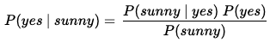
Steps to Apply Bayes Theorem
Play no yes Row Total weather Sunny 2 3 5 P(Sunny)= 5/14 Overcast 0 4 4 P(Overcast) = 4/14 Rainy 3 2 5 P(Rainy)=5/14 Column Total 5 9 14
P(no)=5/14 P(yes)=9/14
Step 4 - Apply probabilities from frequency table to Bayes theorem

Slide 40













Slide 41
Example 2:
S. No | Outlook | Temp | Humidity | Windy | Play Tennis
1 | Rainy | Hot | High | False | No
2 | Rainy | Hot | High | True | No
3 | Overcast | Hot | High | False | Yes
4 | Sunny | Mild | High | False | Yes
5 | Sunny | Cool | Normal | False | Yes
6 | Sunny | Cool | Normal | True | No
7 | Overcast | Cool | Normal | True | Yes
8 | Rainy | Mild | High | False | No
9 | Rainy | Cool | Normal | False | Yes
10 | Sunny | Mild | Normal | False | Yes
11 | Rainy | Mild | Normal | True | Yes
12 | Overcast | Mild | High | True | Yes
13 | Overcast | Hot | Normal | False | Yes
14 | Sunny | Mild | High | True | No
If the features of today = (Outlook is Sunny, Temp is Hot, Humidity is Normal, Windy is False),
then the player will play or not?

Slide 42
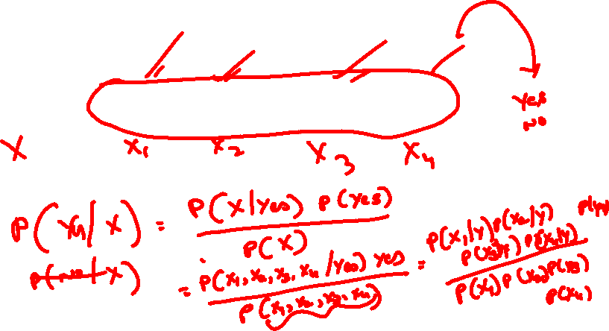
today = (Sunny, Hot, Normal, False)

Slide 43
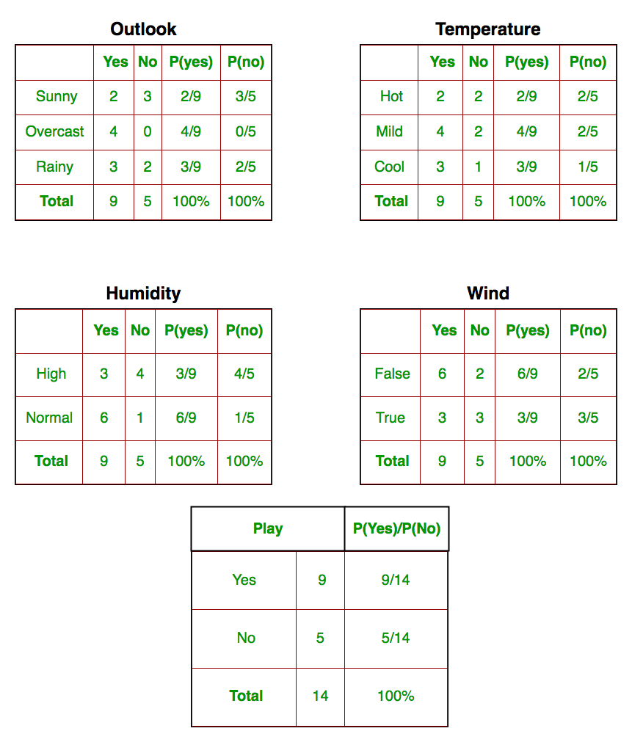

Slide 44
Example 3:
Magazine Promotion | Watch Promotion | Life Insurance Promotion | Credit Card Insurance | Sex
Yes | No | No | No | Male
Yes | Yes | Yes | Yes | Female
No | No | No | No | Male
Yes | Yes | Yes | Yes | Male
Yes | No | Yes | No | Female
No | No | No | No | Female
Yes | Yes | Yes | Yes | Male
No | No | No | No | Male
Yes | No | No | No | Male
Yes | Yes | Yes | No | Female
New Instance: Magazine Promotion = Yes , Watch Promotion = Yes, Life Insurance Promotion = No, Credit Card Insurance = No then Sex = ?

Slide 45



Slide 46



Slide 47







Slide 48



Slide 49
Example 4:
A: attributes
M: mammals
N: non-mammals
P(A|M)P(M) > P(A|N)P(N)
=> Mammals

Slide 50
Issues with Naïve Bayes Classifier
Naïve Bayes Classifier:
P(Refund = Yes | No) = 3/7
P(Refund = No | No) = 4/7
P(Refund = Yes | Yes) = 0
P(Refund = No | Yes) = 1
P(Marital Status = Single | No) = 2/7
P(Marital Status = Divorced | No) = 1/7
P(Marital Status = Married | No) = 4/7
P(Marital Status = Single | Yes) = 2/3
P(Marital Status = Divorced | Yes) = 1/3
P(Marital Status = Married | Yes) = 0
For Taxable Income:
If class = No: sample mean = 110
sample variance = 2975
If class = Yes: sample mean = 90
sample variance = 25
P(Yes) = 3/10
P(No) = 7/10
P(Yes | Married) = 0 x 3/10 / P(Married)
P(No | Married) = 4/7 x 7/10 / P(Married)

Slide 51
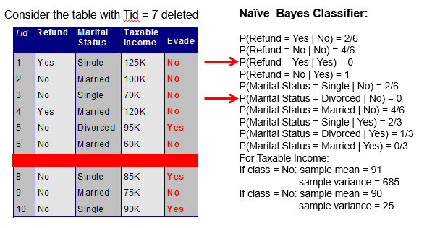
Issues with Naïve Bayes Classifier
Given X = (Refund = Yes, Divorced, 120K)
P(X | No) = 2/6 X 0 X 0.0083 = 0
P(X | Yes) = 0 X 1/3 X 1.2 X 10⁻⁹ = 0
Naïve Bayes will not be able to classify X as Yes or No!

Slide 52
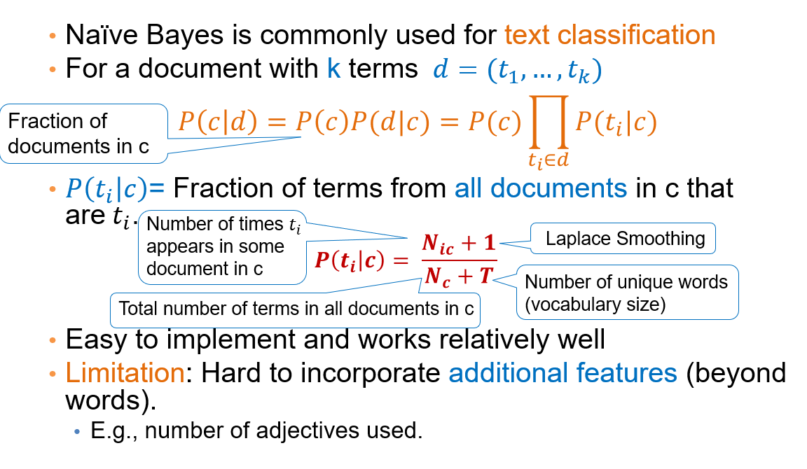
Naïve Bayes for Text Classification

Slide 53
A Simple Example:
Text | Tag
“A great game” | Sports
“The election was over” | Not sports
“Very clean match” | Sports
“A clean but forgettable game” | Sports
“It was a close election” | Not sports
Which tag does the sentence A very close game belong to? i.e. P(sports| A very close game)
Feature Engineering: Bag of words i.e use word frequencies without considering order
Using Bayes Theorem:
P(sports| A very close game)
= P(A very close game| sports) P(sports)
----------------------------------------------
P(A very close game)
We assume that every word in a sentence is independent of the other ones
“close” doesn’t appear in sentences of sports tag, So P(close | sports) = 0, which makes product 0

Slide 54
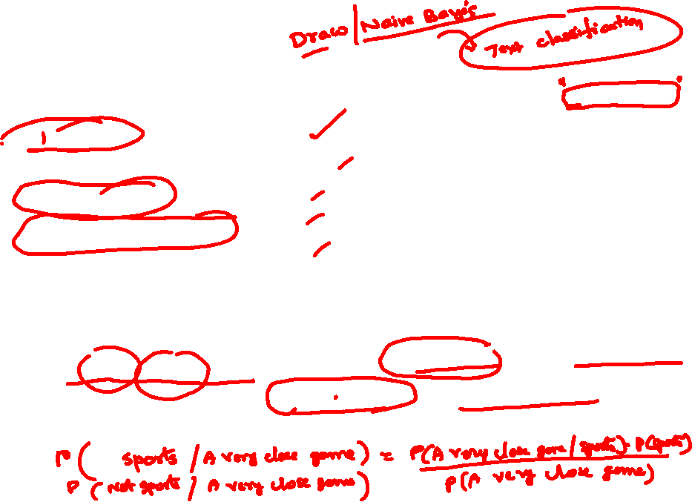
A Simple Example
Text | Tag
“A great game” | Sports
“The election was over” | Not sports
“Very clean match” | Sports
“A clean but forgettable game” | Sports
“It was a close election” | Not sports
Which tag does the sentence A very close game belong to? i.e. P(sports| A very close game)
Feature Engineering: Bag of words i.e use word frequencies without considering order
Using Bayes Theorem:
P(sports| A very close game)
= P(A very close game| sports) P(sports)
----------------------------------------------
P(A very close game)
We assume that every word in a sentence is independent of the other ones
“close” doesn’t appear in sentences of sports tag, So P(close | sports) = 0, which makes product 0

Slide 55
Laplace smoothing
Laplace smoothing: we add 1 or in general constant k to every count so it’s never zero.
To balance this, we add the number of possible words to the divisor, so the division will never be greater than 1
In our case, the possible words are ['a', 'great', 'very', 'over', 'it', 'but', 'game', 'election', 'clean', 'close', 'the', 'was', 'forgettable', 'match'].

Slide 56
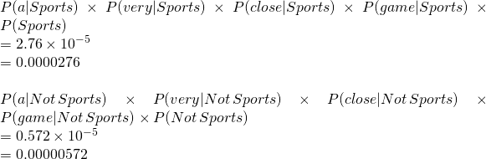
Apply Laplace Smoothing
Word | P(word | Sports) | P(word | Not Sports)
a | 2+1 / 11+14 | 1+1 / 9+14
very | 1+1 / 11+14 | 0+1 / 9+14
close | 0+1 / 11+14 | 1+1 / 9+14
game | 2+1 / 11+14 | 0+1 / 9+14

Slide 57
Example :
Doc No | Text
1 | I LOVED THE MOVIE
2 | I HATED THE MOVIE
3 | A GREAT MOVIE ,GOOD MOVIE
4 | POOR ACTING
5 | GREAT ACTING , A GOOD MOVIE
NEW | I HATED THE POOR ACTING

Slide 58
Example :
Doc No | Text
1 | I LOVED THE MOVIE _POSITIVE
2 | I HATED THE MOVIE _ NEGATIVE
3 | A GREAT MOVIE ,GOOD MOVIE _POSITIVE
4 | POOR ACTING _NEGATIVE
5 | GREAT ACTING , A GOOD MOVIE _POSITIVE
NEW | I HATED THE POOR ACTING _????

Slide 59


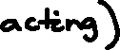
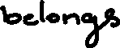
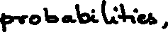



Slide 60




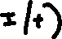
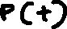




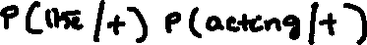

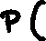
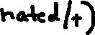





Slide 61

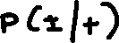




Slide 62



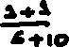

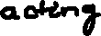


Slide 63
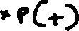









Slide 64
Example:
Email word | Spam | Email word | Spam
Dear | Yes | Friend | No
Friend | No | Friend | Yes
Dear | No | Dear | No
Dear | No | Lunch | No
Dear | No | Friend | No
Friend | No | Dear | No
Lunch | No | Dear | No
Friend | No | Dear | No
Lunch | No | Dear | No
Dear | Yes | Money | Yes
Money | Yes | Money | No
Money | Yes | Money | Yes
Suppose we got the new message with the words ‘Dear Friend’, Decide whether this new message is a normal or spam message?
i.e. Normal/ Dear, Friend = Yes or No
Note if we know P (Normal/ Dear, Friend ) and P(Spam/ Dear, Friend ) then we can answer the question asked

Slide 65
Steps to Apply Bayes Theorem
Step 1- View or collect “raw” data.
Step 2 - Convert long data to a frequency table
Play normal spam Row Total word Dear 8 2 10 Friend 5 1 6 Lunch 3 0 3 Money 1 4 5
Column Total 17 7 24
Step 3 - Row and column sums to get probabilities
Email word | Spam | Email word | Spam
Dear | Yes | Friend | No
Friend | No | Friend | Yes
Dear | No | Dear | No
Dear | No | Lunch | No
Dear | No | Friend | No
Friend | No | Dear | No
Lunch | No | Dear | No
Friend | No | Dear | No
Lunch | No | Dear | No
Dear | Yes | Money | Yes
Money | Yes | Money | No
Money | Yes | Money | Yes

Slide 66

Steps to Apply Bayes Theorem
Play normal spam Row Total word Dear 8 2 10 Friend 5 1 6 Lunch 3 0 3 Money 1 4 5
Column Total 17 7 24
Step 4 - Apply probabilities from frequency table to Bayes theorem
As P (N/ D, F ) > P (S/ D, F ) , we can decide that Dear Friend is Normal message.
P (N/ D, F )= $\frac{\text{P}\text{ (}\text{D}\text{, }\text{F}\text{/}\text{N}\text{ )}\text{.}\text{P}\text{(}\text{N}\text{)}}{\text{P}\text{ (}\text{D}\text{, }\text{F}\text{)}}$ = $\frac{\text{P}\text{ (}\text{D}\text{/}\text{N}\text{ ).}\text{P}\text{(}\text{F}\text{/}\text{N}\text{).}\text{P}\text{(}\text{N}\text{)}}{\text{P}\text{ (}\text{D}\text{).}\text{P}\text{(}\text{F}\text{)}}$ =$\frac{\left(\frac{8}{17}\right).\left(\frac{5}{17}\right).\left(\frac{17}{24}\right)}{\left(\frac{10}{24}\right).(\frac{6}{24})}=\frac{0.098}{0.104}$ =0.9423
P (S/ D, F )= $\frac{\text{P}\text{ (}\text{D}\text{, }\text{F}\text{/}\text{S}\text{ )}\text{.}\text{P}\text{(}\text{S}\text{)}}{\text{P}\text{ (}\text{D}\text{, }\text{F}\text{)}}$ = $\frac{\text{P}\text{ (}\text{D}\text{/}\text{S}\text{ ).}\text{P}\text{(}\text{F}\text{/}\text{S}\text{).}\text{P}\text{(}\text{S}\text{)}}{\text{P}\text{ (}\text{D}\text{).}\text{P}\text{(}\text{F}\text{)}}$ =$\frac{\left(\frac{2}{7}\right).\left(\frac{1}{7}\right).\left(\frac{7}{24}\right)}{\left(\frac{10}{24}\right).(\frac{6}{24})}=\frac{0.012}{0.104}$ =0.1153

Slide 67
Example continued:
Email word | Spam | Email word | Spam
Dear | Yes | Friend | No
Friend | No | Friend | Yes
Dear | No | Dear | No
Dear | No | Lunch | No
Dear | No | Friend | No
Friend | No | Dear | No
Lunch | No | Dear | No
Friend | No | Dear | No
Lunch | No | Dear | No
Dear | Yes | Money | Yes
Money | Yes | Money | No
Money | Yes | Money | Yes
Suppose we got the new message contains the word ‘Lunch Money Money Money Money’ , Decide whether this new message is a normal or spam message?

Slide 68


Steps to Apply Bayes Theorem
Play normal spam Row Total word Dear 8 2 10 Friend 5 1 6 Lunch 3 0 3 Money 1 4 5
Column Total 17 7 24
Step 4 - Apply probabilities from frequency table
We can observe that we have to classify any message with Lunch as Normal message, no matter how many times we see the word Money and that’s the problem.
To work around this problem add 1 count to the frequency table to each word(Laplace smoothing)
P(N). P(L/N). P(M/N)⁴=$\left(\frac{17}{24}\right).\left(\frac{3}{17}\right).{\left(\frac{1}{17}\right)}^{4}=$0.0000015
P(S). P(L/S). P(M/S)⁴=$\left(\frac{7}{24}\right).\left(\frac{0}{7}\right).{\left(\frac{4}{7}\right)}^{4}=$0

Slide 69


Steps to Apply Bayes Theorem
Play normal spam Row Total word Dear 8+1 2+1 12 Friend 5+1 1+1 8 Lunch 3+1 0+1 5 Money 1+1 4+1 7
Column Total 21 11 32
Step 4 - Apply probabilities from frequency table
As P (S/ L, M⁴ ) > P (N/ L, M⁴ ) , we can decide that Lunch Money Money Money Money is Spam message.
P(N). P(L/N). P(M/N)⁴=$\left(\frac{21}{32}\right).\left(\frac{4}{21}\right).{\left(\frac{2}{21}\right)}^{4}=$0.00001
P(S). P(L/S). P(M/S)⁴=$\left(\frac{11}{32}\right).\left(\frac{1}{11}\right).{\left(\frac{5}{11}\right)}^{4}=$0.00133

Slide 70

Naïve Bayes Classifier Applications

Slide 71
Naive Bayes Classifier
Along with decision trees, neural networks, one of the most practical learning methods.
When to use
Moderate or large training set available
Attributes that describe instances are conditionally independent given classification
Successful applications:
Diagnosis
Classifying text documents

Slide 72
Learning to Classify Text
Why?
Learn which news articles are of interest
Learn to classify web pages by topic
Naive Bayes is among most effective algorithms
What attributes shall we use to represent text documents??

Slide 73

Baseline: Bag of Words Approach
aardvark 0
about 2
all 2
Africa 1
apple 0
anxious 0
...
gas
...
oil
… Zaire

Slide 74
Practical Issues of Bayesian learning
Require initial knowledge of many probabilities
Often estimated based on background knowledge, previously available data, and assumptions about the form of the underlying distributions.
Significant computational cost required to determine the Bayes optimal hypothesis in the general case (linear in the number of candidate hypotheses)

Slide 75

HW: Exercise
Consider the car theft problem with attributes Color, Type, Origin, and the target, Stolen can be either Yes or No.
we need to classify whether the car is stolen, given the features of the car.
Given the Red color Domestic SUV car Find the probability of whether the car is stolen?

Slide 76
HW: Exercise
weather | Player play
Sunny | yes
Rainy | no
Cloudy | yes
Sunny | no
Sunny | yes
snowy | no
Rainy | yes
Cloudy | no
Cloudy | yes
Sunny | yes
snowy | no
Cloudy | yes
Rainy | no
snowy | no
snowy | yes
If the weather is Snowy,
then the player will play
or not?

Slide 77
Thanks

